Slide 1
Navigation in classic
May 2011
Notes:
© 2006 Capgemini - All rights reserved
0

Slide 2
What You Will Learn In This Session
At the end of the session you will have
Adequate knowledge to understand
Navigation with in T24 when connected using a terminal emulation software
Moving from T24 to the database prompt
Notes:
Trainee notes

Slide 3
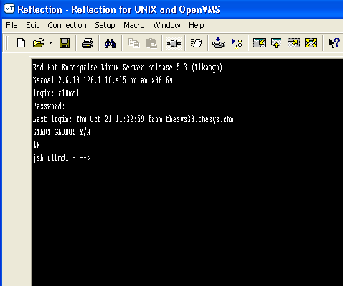
Logging On To T24 Using A Terminal Emulation Software
Login into T24 (Classic user interface)
Terminal Emulation Software
Putty
Reflection
Telnet command
Supply Unix user name and password
Type ‘N’ to get to the jsh prompt.
Type ‘Y’ to login into T24

Slide 4
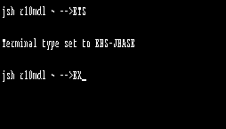
Logging On To T24 Using A Terminal Emulation Software
Type the following to login to T24 from jsh
ETS – EBS.TERMINAL.SELECT to set the terminal type (Terminal type set will be EBS-JBASE)
EX (Exit from jsh and login into T24)

Slide 5
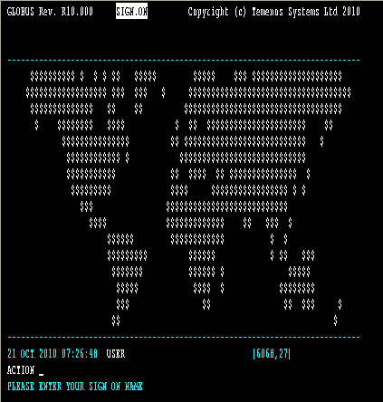
Logging On To T24 Using A Terminal Emulation Software
T24 will prompt for sign on name and password. This is the T24 sign on name and password. Supply it. Both sign on name and password will not appear when typed. They are masked

Slide 6
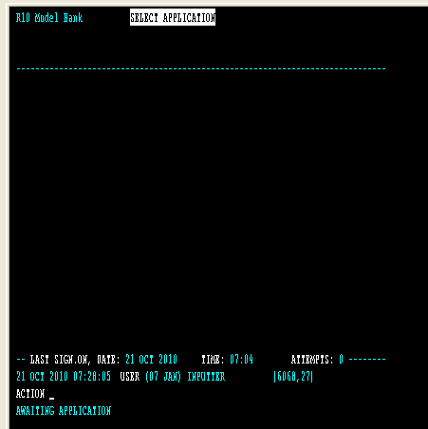
Navigation In Classic

Slide 7
Commands From The Awaiting Application Prompt
At the awaiting application prompt
Open an existing record in the CUSTOMER application
CUSTOMER I <ID>
Open a new record in the CUSTOMER application
CUSTOMER I Ctrl + F + Enter
While inside the record
Move to the next field
<Enter> (or) Ctrl + F + <Enter>
Move to the previous field
Ctrl + B + <Enter>
Commit a record
Ctrl + V + <Enter> (or) Ctrl + VV + <Enter>
Quit without saving the record
Ctrl + U + <Enter> (or) Ctrl + K + <Enter>

Slide 8
Commands From The Awaiting Application Prompt
Move to the next page
Ctrl + F + <Enter>
Move to the previous page
Ctrl + B + <Enter>
Move to the last page of the record
Ctrl + E + <Enter>
Move to a single value field
Field Number (Example : To move to field number 2 type 2 )
Move to a multi value field
Field Number.Multi value position (Example : 2.1)
Move to a sub value field
Field Number.Sub value position (Example : 2.1.1)

Slide 9
Commands From With A Record
Multi value a field (Go to the specific field) <
Multi value the field above the current field >
Sub value a field (Go to the specific field) (
Sub value the field above the current field )
Delete a multi/sub value -
Return to the Awaiting Application Prompt Ctrl + E + <Enter>

Slide 10
Commands From With A Record
Obtain help on a field
? <Field Number>
Help text needs to be installed for this feature to work
Specify only the field number (Not the multi value or the sub value number)

Slide 11
Other Useful Tips In Navigation
List the valid values of a field
Field contains values that belong to another field in T24
Example : CUSTOMER field in the ACCOUNT application contains a list of valid customer numbers only

Slide 12
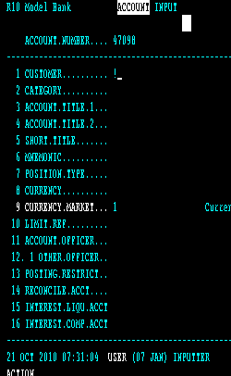
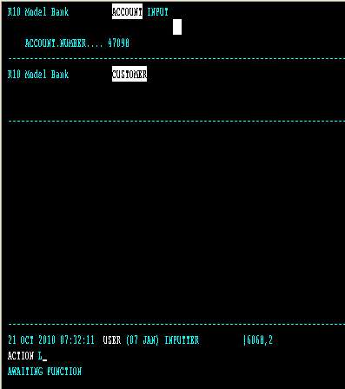
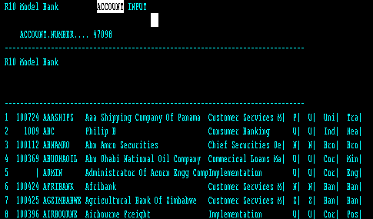
Other Useful Tips In Navigation
Type !
The CUSTOMER application gets opened. Type L at the Awaiting Function Prompt to list the valid customers
List of customers is listed. To choose a customer
Type the record number (sequence number)
Cursor will get placed at the end of the chosen record
Type C to copy the ID
Type Ctrl+V+Enter to commit
The chosen record ID will get copied to the field CUSTOMER in the ACCOUNT application

Slide 13
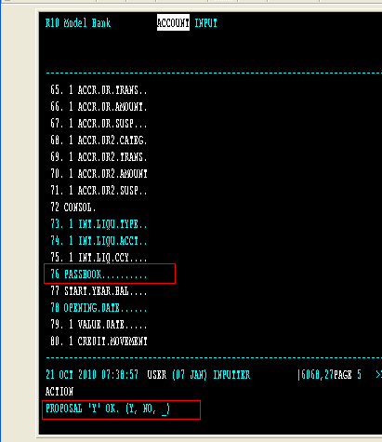
Other Useful Tips In Navigation
List the valid values of a field
Field contains user defined values
PASSBOOK field in the ACCOUNT application can either hold Y or N

Slide 14
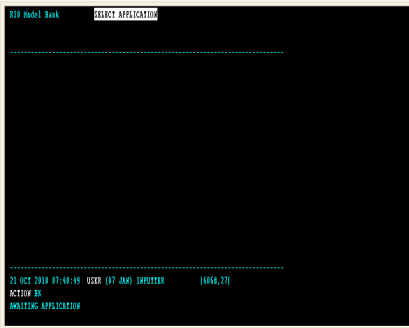
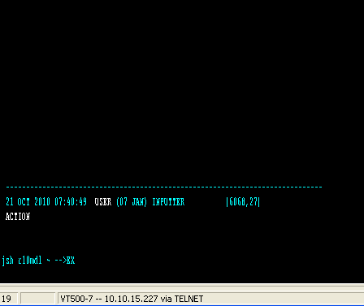
Moving From T24 To The Database Prompt And Vice Versa

Slide 15
Summary
EBS.TERMINAL.SELECT is used to set the terminal type. Choose terminal type EBS-JBASE
You may also use ETS to perform the above task
ETS sets the terminal type to EBS-JBASE
EX command is used to quit jsh and takes the user to the T24 Login screen.
Commands can be executed at
Application level
Record level
BK command is used to quit T24 and takes the user to jsh prompt

Slide 16


www.capgemini.com/financialservices

